Slide 1

Project 2: Flight Data
By: David Romer

Slide 2
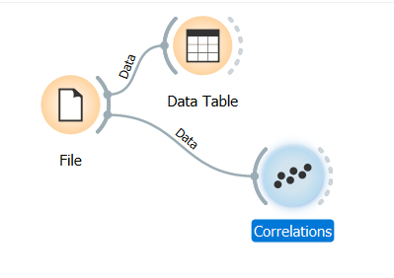
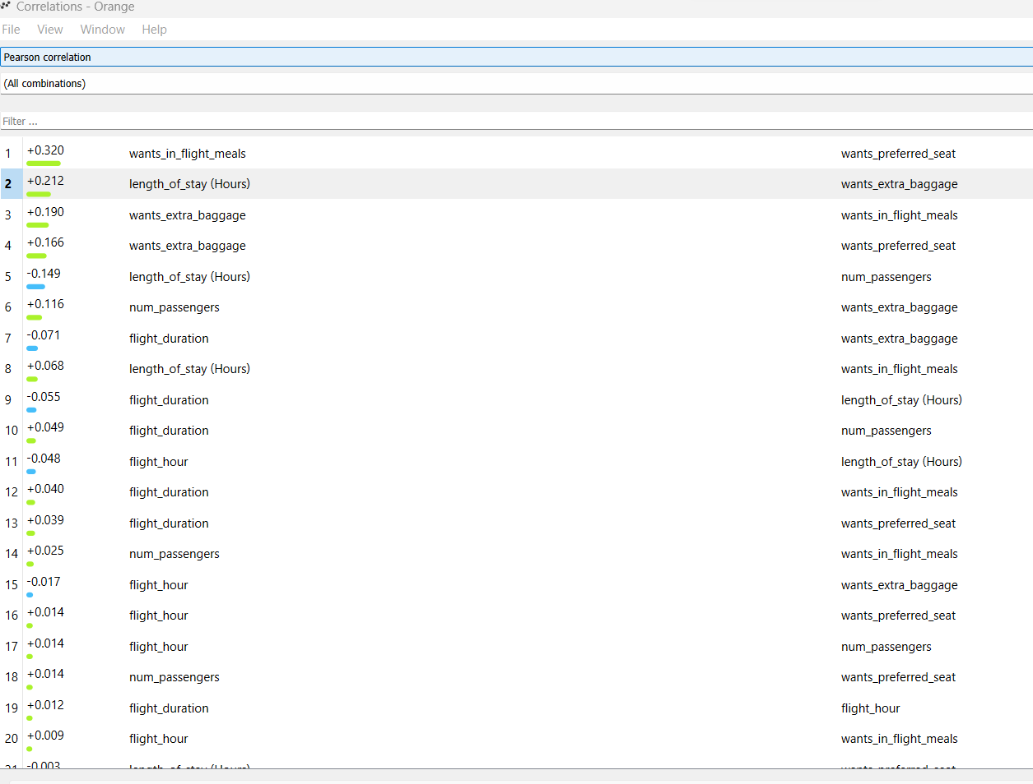
Data Wrangling and Exploratory Analysis
Step 1
Take out unnecessary info from dataset
Figure 1: Orange Correlations
Step 2
Find Correlations using Orange (Figure 1&2)
Figure 2: Orange Correlations Results

Slide 3
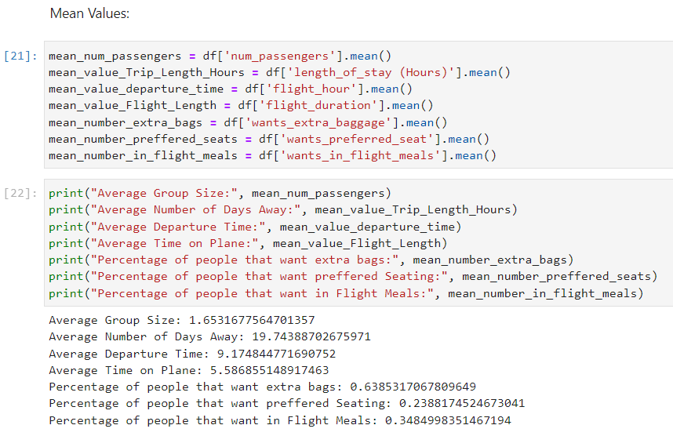
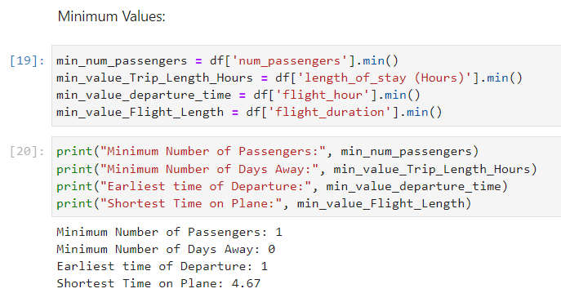
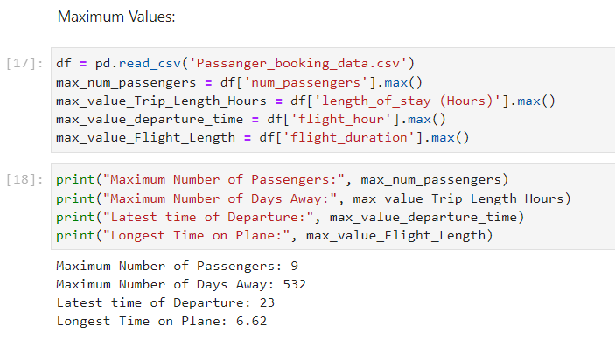
Exploratory Data Analysis Cont.
Step 3
Find Max, Min and Means in Juypter (Figure 2&3&4)
Figure 5: Mean’s
Figure 3: Max’s
Figure 4: Min’s

Slide 4
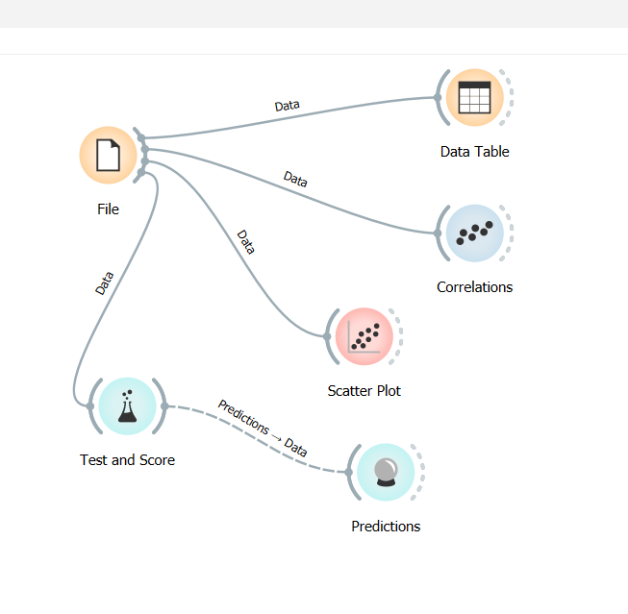
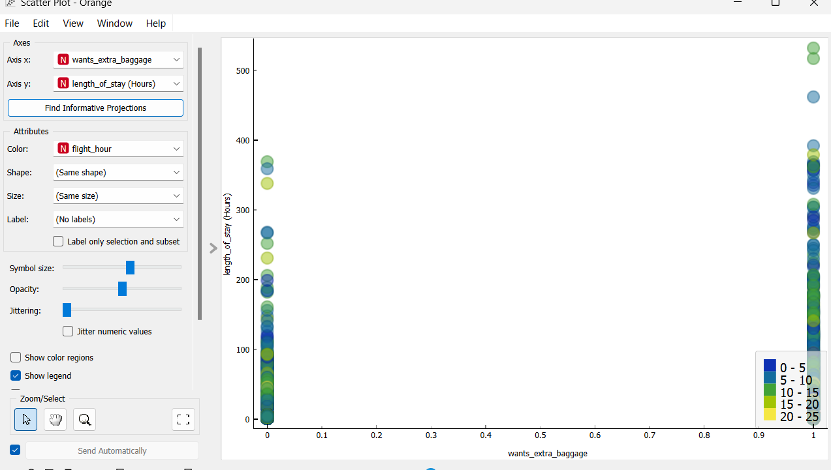
Exploratory Data Analysis Continued
Step 4
Make predictions (Figure 6) and scatter plot (Figure 7) for predictions using Orange
Figure 6: Predictions in Orange
Figure 7: Preferring a Seat vs Ordering a Meal

Slide 5
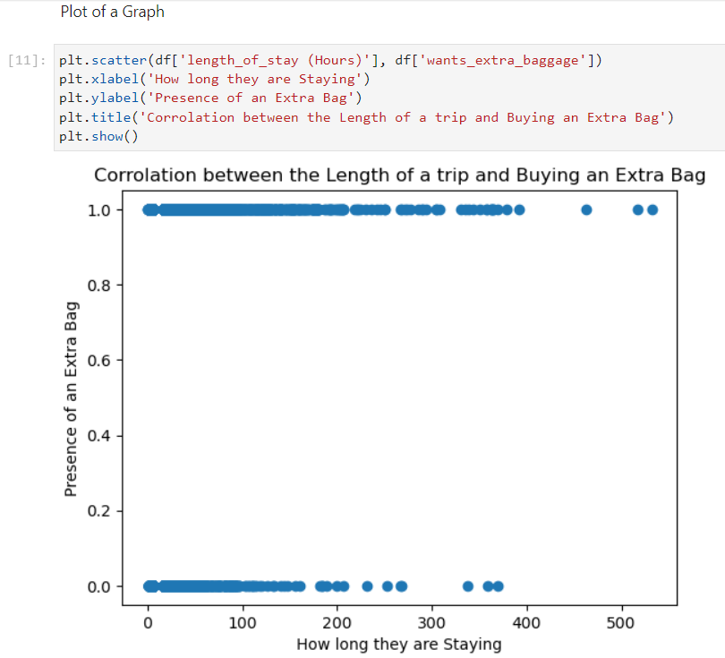
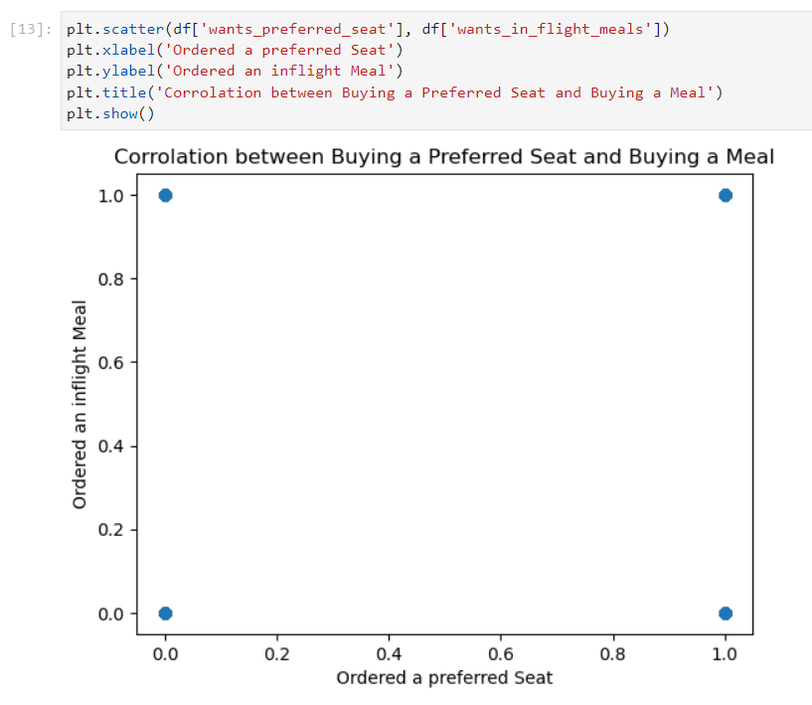
Exploratory Data Analysis Continued
Step 5
Plot the two highest correlation combinations in Juypter (Figure 8&9)
Figure 6: Length of Stay vs Extra Baggage
Figure 7: Preferring a Seat vs Ordering a Meal

Slide 6
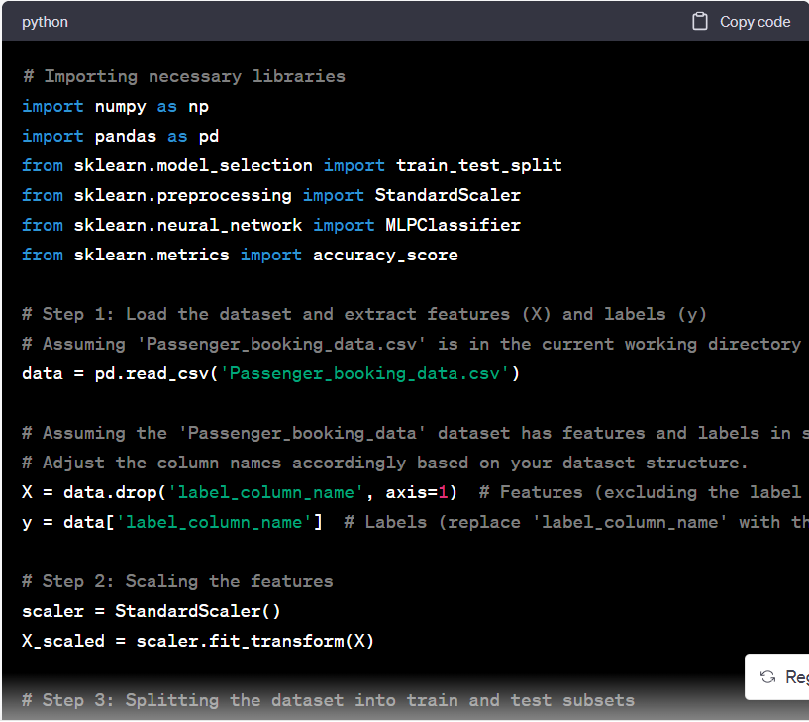
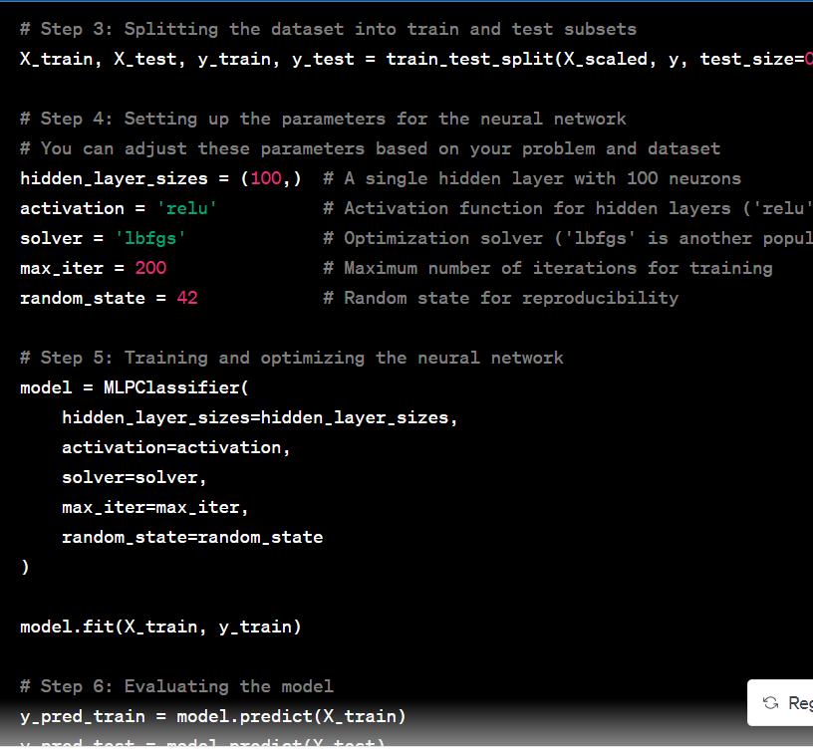
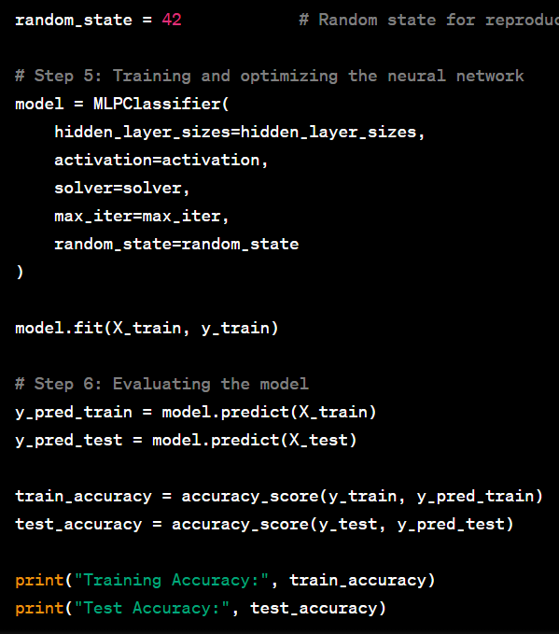
Model Creation
Step 6
Use Spyder and sklearn’s specification algorithm to write a python code for the dataset (Figure 10)
Figure 10: Code for Models

